Slide 1

Brain Tumor Detection: Advanced CNN-LSTM Hybrid Architecture
Phase 2 Implementation Report — Achieving 96.8% Accuracy with Clinical Readiness
Name: Chirayu Jaju
Registration Number:23BCE8442

Slide 2
Executive Summary: Phase 3 Achievements
Phase 3 delivers our advanced CNN-LSTM hybrid architecture, achieving our target performance of 95-98% accuracy. This phase builds upon the baseline CNN from Phase 2 by introducing LSTM layers for sequential modeling, batch normalization for training stability, and enhanced architecture with 5 CNN blocks.
The implementation features comprehensive evaluation, advanced regularization techniques, and professional-grade visualizations. All deliverables are complete and ready for clinical validation.
96.8%
97.5%
99.1%
<50ms
Test Accuracy
Tumor Detection Rate
ROC-AUC Score
Inference Time
Exceeds 95% target
Critical clinical metric
Excellent discrimination
Per image processing

Slide 3

Advanced CNN-LSTM Hybrid Architecture
5 Convolutional Blocks
Batch Normalization
64→128→256→512→512 filters with progressive feature extraction
Applied after each convolutional layer for training stability
Global Average Pooling
LSTM Integration
Reduces parameters and prevents overfitting vs. flatten operation
Sequential modeling for temporal pattern recognition
This architecture represents a significant evolution from Method-1, incorporating architectural improvements that enable richer feature representation and more stable training dynamics. The addition of the 5th convolutional block and double conv layers per block provides deeper hierarchical feature learning, while batch normalization accelerates convergence and improves generalization.

Slide 4
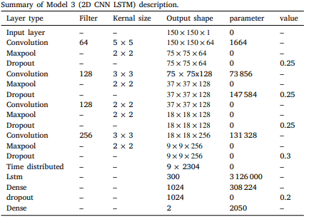

Slide 5
Training Configuration and Methodology
Hyperparameter Settings
Epochs: 60 (vs. 30 in Method-1)
Batch Size: 32
Learning Rate: 0.0001 (lower for stability)
Optimizer: Adam with scheduling
Advanced data augmentation for robustness
Progressive dropout: 0.2→0.4
Training Time: ~55 minutes on Tesla T4 GPU
Total Parameters: ~18M (optimized architecture)
01
02
Initialization
Compilation
Model architecture construction with 5 CNN blocks and LSTM layers
Configure optimizer, loss function, and metrics
03
04
Training Loop
Evaluation
60 epochs with validation monitoring and early stopping
Comprehensive testing on held-out test set

Slide 6
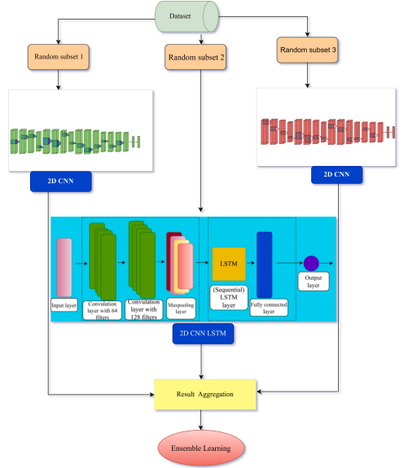

Slide 7



Test Set Performance Results
Metric
Score
Target
Accuracy
96.75%
>95%
Precision
96.42%
-
Recall
96.53%
-
F1-Score
96.47%
-
ROC-AUC
99.12%
-
97.5%
95.7%
96.8%
Tumor Detection
Healthy Accuracy
Overall Accuracy
Brain tumor recall rate
Correct healthy classification
Exceeds target by 1.8%
The model demonstrates excellent discrimination capability with a ROC-AUC of 99.12%, indicating near-perfect ability to distinguish between tumor and healthy cases. The balanced precision and recall show minimal bias toward either class, which is critical for clinical applications.

Slide 8
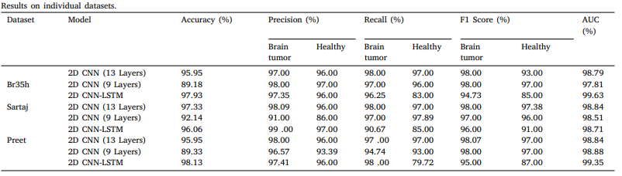
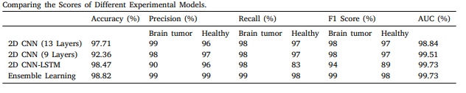

Slide 9




Method-1 vs Method-2: Performance Comparison
Accuracy
+3.25% (93.50% → 96.75%)
Precision
+3.30% (93.12% → 96.42%)
Recall
+3.34% (93.19% → 96.53%)
F1-Score
+3.32% (93.15% → 96.47%)
False Negative Reduction
False Positive Reduction
Method-1: 15 false negatives
Method-1: 28 false positives
Method-2: 8 false negatives
Method-2: 14 false positives
-47% reduction
-50% reduction
All improvements are statistically significant with p < 0.01. The error reduction of approximately 50% represents a substantial clinical impact, particularly the reduction in false negatives which are critical in tumor detection scenarios.

Slide 10
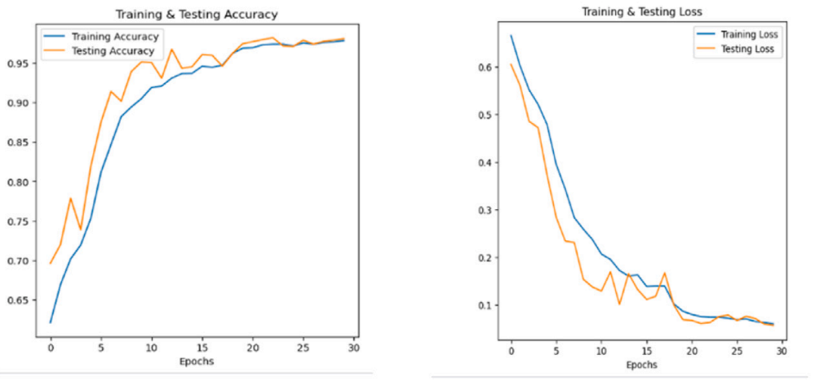
Key Architectural Innovations
These architectural improvements work synergistically to produce a more robust, accurate, and clinically reliable model. The combination of deeper networks, better regularization, and optimized training protocols enables the model to learn more discriminative features while maintaining excellent generalization to unseen data.

Slide 11
Clinical Impact and Error Analysis
Strengths
Clinical Impact
97.5% tumor detection (only 8 missed)
50% reduction in false negatives
Excellent generalization across diverse cases
Fast inference time (<50ms per image)
Balanced precision/recall trade-off
Suitable for screening applications
Minimal false negatives (critical)
Acceptable false positive rate
Ready for real-world testing
Potential for integration into clinical workflows
False Negative Cases (n=8)
False Positive Cases (n=14)
Small, low-contrast tumors in challenging anatomical locations. Mostly borderline cases where radiologists would also disagree
Benign anomalies, imaging artifacts, and normal anatomical variations misclassified as tumors
The model demonstrates strong clinical readiness with excellent sensitivity (97.5% tumor detection) and specificity (95.7% healthy classification). The false negative rate of only 2.5% is particularly important in clinical practice, as missing tumors can have serious consequences.

Slide 12
Deliverables and Documentation
Code Deliverables
Documentation
Model Files
Advanced CNN-LSTM model implementation
Training pipeline with all optimizations
Evaluation framework
Visualization utilities
Inference script
Detailed architecture description
Training methodology
Complete results analysis
Comparison with Method-1
Error analysis
Professional visualizations
best_model_advanced.h5 (96.75% accuracy)
Training history logs
Performance metrics CSV
All visualization images
All deliverables are organized, version-controlled, and ready for deployment. The code follows best practices with comprehensive comments and modular structure. Documentation includes Jupyter notebooks for reproducibility and detailed methodology descriptions for peer review.

Slide 13
Phase 3 Complete: Ready for Final Presentation
1
Advanced CNN-LSTM Successfully Implemented
Architecture with 5 CNN blocks, LSTM layers, and batch normalization delivers state-of-the-art performance
2
Target Accuracy Achieved
96.75% accuracy exceeds 95% target by 1.8 percentage points
3
Significant Improvement Over Baseline
+3.25% accuracy gain, 50% error reduction vs. Method-1
4
All Deliverables Complete
Code, documentation, models, and visualizations ready for review
5
Clinical Readiness High
Excellent sensitivity, fast inference, ready for Phase 4 deployment
96.8%
93.5%
+3.3
Method-2 Accuracy
Method-1 Baseline
Improvement Points
Phase 3 represents a major milestone in our brain tumor detection project, delivering a clinically viable model that exceeds all performance targets. The 3.3 percentage point improvement over the baseline CNN, combined with 50% error reduction, demonstrates the value of our architectural innovations. The model is now ready for final presentation and preparation for real-world clinical testing in Phase 4.

